Slide 1
Combinatorial Testing Strategies
Alex Wang

Slide 2
Overview
Testing consumes a significant amount of the resources in developing software
It’s important to increase the efficiency and effectiveness in testing

Slide 3
Existing Methods
Partition Testing
  Select test-cases manually
  Coverage relates to partition model
Random Testing
  Unrealistic
  Overall failure probability was too high

Slide 4
Combination Strategies
A class of test-case selection where test cases are identified by choosing certain values
Then combining the values selected to generated the test suite

Slide 5
Categories of Combination Strategies
Non-deterministic
  Heuristic: AETG
  Rand:
Deterministic
  Instant: OA, CA
  Iterative:
  Parameter-based: IPO
Compound

Slide 6
Coverage Criteria
Each-used
  Simplest coverage criterion
Pair-wise
  Every possible pair of values
t-wise
N-wise

Slide 7
Heuristic t-wise
Chance play a certain role in determining which tests are generated
The same preconditions may produce different results

Slide 8
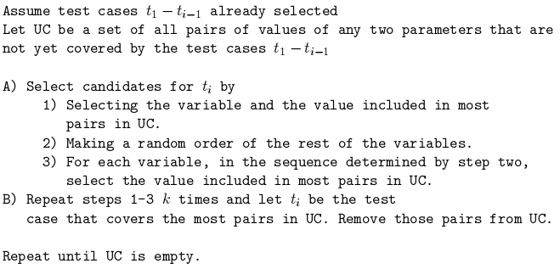
AETG

Slide 9
Papers
R. Brownlie, J. Prowse, and M.S. Phadke
Robust Testing of AT&T PMX/StarMAIL using OATS
AT&T Technical Journal, May/June 1992, pp. 41-47
D. M. Cohen, S. R. Dalal, M. L. Fredman, and G. C. Patton
The AETG System: An Approach to Testing Based on Combinatorial Design
IEEE Transactions On Software Engineering, July 1997 (Vol. 23, No. 7)
A.W. Williams, R.L. Probert
A practical strategy for testing pair-wise coverage of network interfaces
The Seventh International Symposium on Software Reliability Engineering (ISSRE '96) p. 246

